Slide 1



Project One
Alaina Fletcher

Slide 2


Introduction and objectives
column | types
b_beverage | string
branch_num | string
beverages
Materials:
HDFS: high availability storage system using the Hadoop framework
Hive: data warehouse software for reading, writing and managing large data set files using HQL an sql like query language
DBeaver: SQL client software application and a database administration tool
.txt files:
Bev_BranchA.txt, Bev_BranchB.txt, Bev_BranchC.txt, Bev_ConscountA.txt, Bev_ConscountB.txt, Bev_ConscountC.txt
Implement simple HIVE commands in real time scenarios on training data in order to demonstrate the output of said commands.
column | types
c_beverage | string
bev_count | int
counts

Slide 3
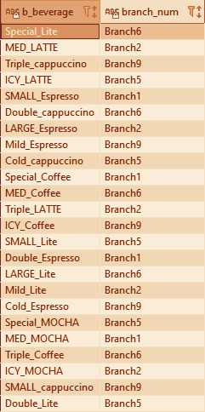
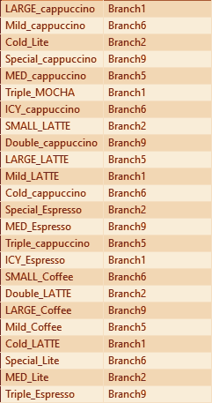
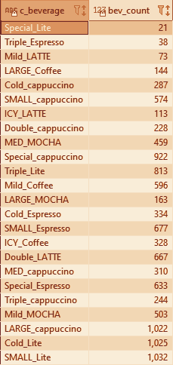
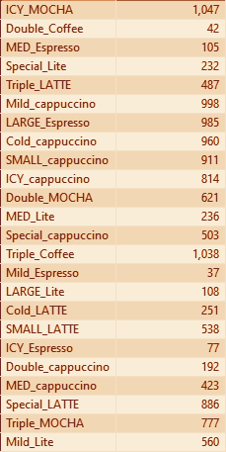
Table set up
create table if not exists
branches(b_beverage string, branch_num string)
row format delimited fields terminated by ',';
load data inpath '/user/alainaf/Bev_BranchA.txt' into table branches;
load data inpath '/user/alainaf/Bev_BranchB.txt' into table branches;
load data inpath '/user/alainaf/Bev_BranchC.txt' into table branches;
create table if not exists
branches(c_beverage string, bev_count int)
row format delimited fields terminated by ',';
load data inpath '/user/alainaf/ Bev_ConscountA.txt' into table branches;
load data inpath '/user/alainaf/Bev_ConscountB.txt' into table branches;
load data inpath '/user/alainaf/ Bev_ConscountC.txt' into table branches;

Slide 4

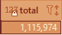
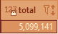
Problem Scenario 1
sum is an example of an aggregate function, as it groups the values of multiple grows together to create a single output
What is the total number of consumers for Branch1?
select sum(counts.bev_count) as total
from branches
full outer join counts
on (branches.b_beverage = counts.c_beverage)
where branches.branch_num = 'Branch1’;
What is the total number of consumers for Branch2?
select sum(counts.bev_count) as total
from branches
full outer join counts
on (branches.b_beverage = counts.c_beverage)
where branches.branch_num = 'Branch1’;

Slide 5
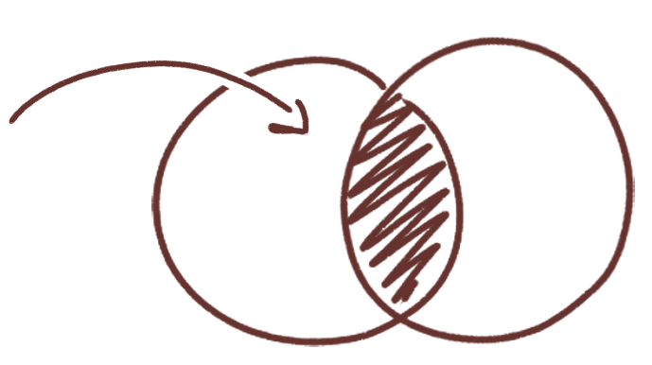

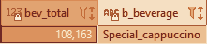

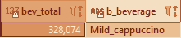
Problem Scenario 2
inner joins show only what two tables have in common, here we only want the counts of drinks that occur on both
here we only want the counts of drinks that occur on both the counts and branch1branch tables
What is the most consumed beverage on Branch1
create table if not exists
branch1branch
as select *
from branches
where branch_num= 'Branch1';
create table if not exists
branch1_countJoin
as select *
from counts
inner join branch1branch
on (branch1branch.b_beverage = counts.c_beverage);
select sum(bev_count) as bev_total,
b_beverage
from branch1_countJoin
group by b_beverage
order by bev_total desc limit 1;
What is the most consumed beverage on Branch2
create table if not exists
branch2branch
as select *
from branches
where branch_num= 'Branch2';
create table if not exists
branch2_countJoin
as select *
from counts
inner join branch2branch
on (branch2branch.b_beverage = counts.c_beverage);
select sum(bev_count) as bev_total,
b_beverage
from branch2_countJoin
group by b_beverage
order by bev_total desc limit 1;

Slide 6
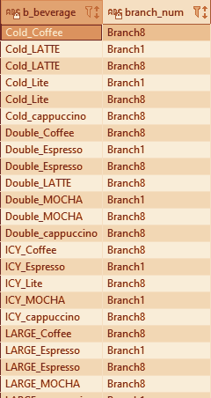
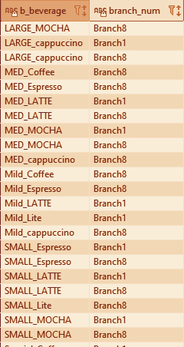
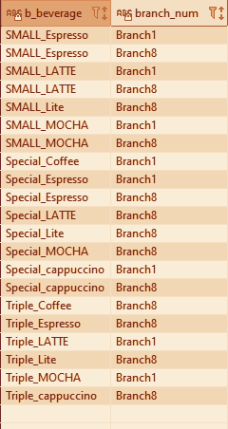

Problem Scenario 3a
What are the beverages available on Branch10, Branch8, and Branch1?
select distinct b_beverage, branch_num
from branches
where branch_num = 'Branch1'
or branch_num = 'Branch8'
or branch_num = 'Branch10';
where clauses filter for certain traits, they are an example of the syntax HQL and SQL have in common

Slide 7
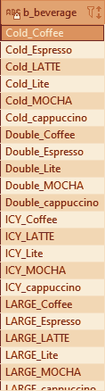
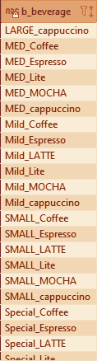
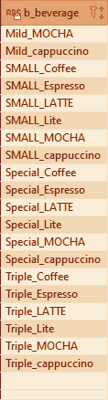

Problem Scenario 3b
What are the common beverages available in Branch4,Branch7?
select b_beverage
from branches
where branch_num = 'Branch4'
intersect
select b_beverage
from branches
where branch_num = 'Branch7';
like an inner join, the intersect function only returns the content of a column(s) that two tables have in common, however it does not join the tables

Slide 8

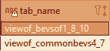
Problem Scenario 4 set up
Create a view for scenario 3
Set up tables for Scenario 4
create view viewOf_bevsOf1_8_10
as select * from bevsOf1_8_10;
create view viewOf_commonBevs4_7
as select select b_beverage
from branches
where branch_num = 'Branch4'
intersect
select b_beverage
from branches
where branch_num = 'Branch7';
show views;
create table if not exists bevsOf1_8_10
as select distinct b_beverage , branch_num
from branches
where branch_num = 'Branch1'
or branch_num = 'Branch8'
or branch_num = 'Branch10';
views allow for more rapid access to commonly queried data
Problem Scenario 4 view

Slide 9


Problem Scenario 4 index
indexing allows for more rapid access of structured data
Create an index for scenario 3(a)
create table indexed_bevsof1_8_10 as
select * from bevsof1_8_10;
create index bev_index on table indexed_bevsof1_8_10(b_beverage) as 'COMPACT' with deferred rebuild;
alter index bev_index on indexed_bevsof1_8_10 rebuild;
show index on indexed_bevsof1_8_10;

Slide 10


Problem Scenario 4 partition
Create a partition for scenario 3(a)
create table part_bevsof1_8_10 (b_beverage string) partitioned by (branch_num string);
set hive.exec.dynamic.partition.mode = nonstrict;
set hive.exec.dynamic.partition=true;
insert into part_bevsof1_8_10 partition (branch_num) select * from bevsof1_8_10;
partitioning allows for more rapid processing of large amounts of data

Slide 11
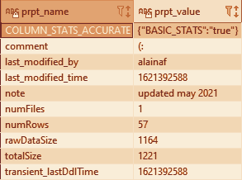
Problem Scenario 5
Alter the table properties to add "note","comment"
alter table bevsOf1_8_10
set tblproperties
('note' = 'updated may 2021',
'comment' = '(:');
show tblproperties bevsOf1_8_10;

Slide 12
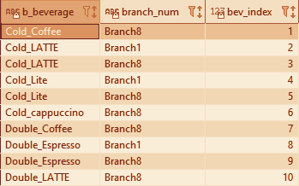
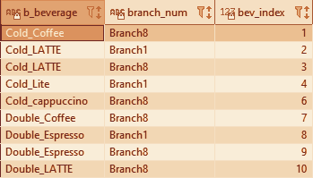
Problem Scenario 6
Remove the row 5 from the output of Scenario 3(a)
row_num creates an index-like column which allows us to easily select and remove row 5
create table if not exists
indexed_bevsOf1_8_10
as select *,
row_number()
over(order by b_beverage)
bev_index
from bevsOf1_8_10;
insert overwrite
table indexed_bevsOf1_8_10
select *
from indexed_bevsOf1_8_10
where bev_index != 5;
select *
from indexed_bevsOf1_8_10;

Slide 13

Conclusion
Examples of table manipulation:
Aggregate functions
Group by
Overwriting
Table joins
Setting and viewing table properties
Ways to optimize
Indexing
Allows for more rapid access to points of structured data
Partitioning
Allows for more rapid processing through parallel processing
Views
Allows for easy access to commonly used statements
As we can see from this short demonstration there is a large amount of utility for real time scenarios made available in Hive, which is made easier to implement thanks to the SQL like syntax of HQL

Slide 14

Thanks a latte!

